Slide 1
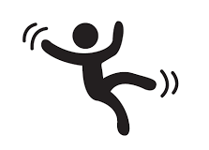
FALL DETECTION
GRADUATION PROJECT PROPOSAL
Khadija Hashad
Supervisor: Dr. Nizar Khemri

Slide 2
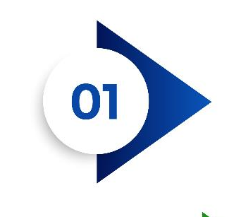



Fall Detection System
Table of Content
INTRODUCTION
ABSTRACT
OUR GOALS
SYSTEM OVERVIEW
BUDGET

Slide 3
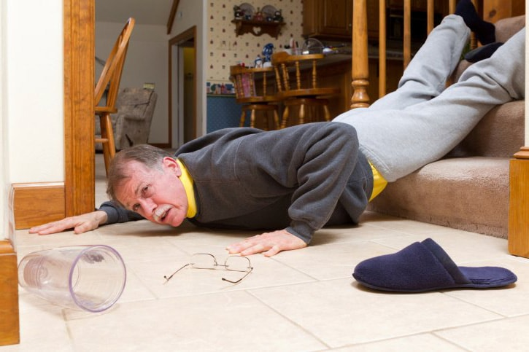
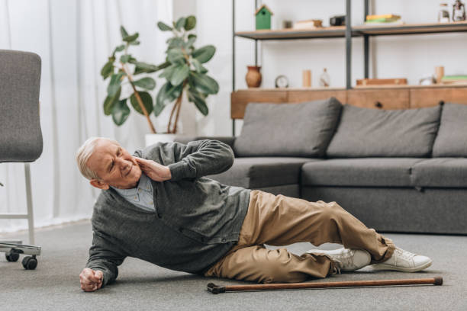
Fall Detection System
Introduction
Falls of the elderly always lead to serious health issues as the decline of their physical fitness.
Fracture is the most common injury in fall of an elderly and there is also a certain possibility to get coma, brain trauma, and paralysis.
At most fall situations, the fall process is the main source of injury because of the high impact.
Older people are the most vulnerable, as they often have chronic diseases that require continuous medical assistance.
Notes:
Falls of the elderly always lead to serious health issues as the decline of their physical fitness.
Fracture is the most common injury in fall of an elderly and there is also a certain possibility to get coma, brain trauma, and paralysis.
At most fall situations, the fall process is the main source of injury because of the high impact. But sometimes the late medical salvage may worsen the situation. That means the faster the salvage comes, the less risk the elderly will face.

Slide 4

Fall Detection System
Introduction
Falls are the second leading cause of unintentional injury deaths worldwide, according to the World Health Organization.
More than 37 million falls each year are severe enough to require medical attention , and people over 60 years old are the most concerned with fatal falls.
The global population of over-60s was estimated to be 962 million in 2017, a number which is expected to double by 2050.
Furthermore, this population increasingly lives in isolated conditions, making falls even more dangerous because immediate assistance cannot always be provided.
Other populations concerned with falls are younger people with disabilities or people recovering from an operation or an injury. There is thus a need for technologies to better handle falls.
Notes:
Older people are the most vulnerable, as they often have chronic diseases that require continuous medical assistance. Any person living alone is at a higher risk of not getting medical care in due time, and special attention must be given to people above 65.
Fall detection is necessary for control over adults with health
issues like:
Recent heart or brain attacks.
Numbness in the extremities.
Injuries, stretches, or breaks.
Weak sight.
Swelling in legs.
Chronic diseases.

Slide 5

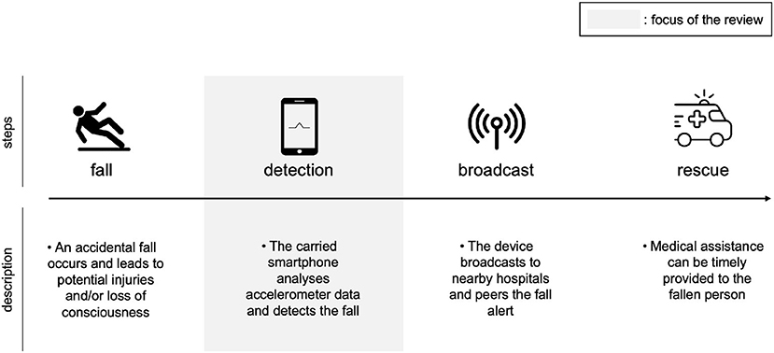


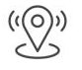
Fall Detection System
Our Goals
The proposed system work as an alert system once a fall occurs.
Our system uses sensors to detect falls and heart rate with the help of GPS and GSM modules to obtain the exact location where the fall occurred, which can be sent to the emergency center or police.
The main effect of this work is to reduce the waiting time for fall victims to receive medical assistance.
Through this implementation, we can detect the condition of the person who fell so that we can provide first aid as soon as possible.

Slide 6
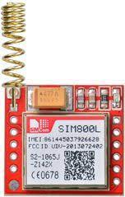
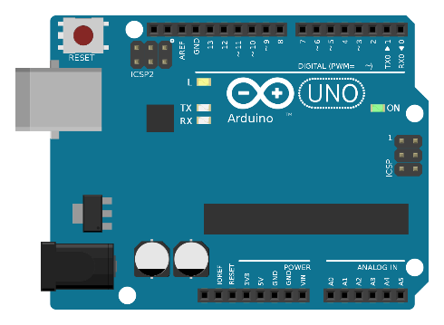
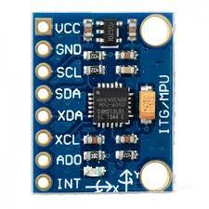
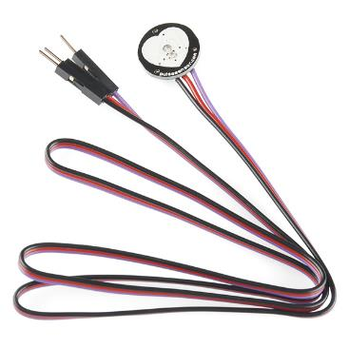
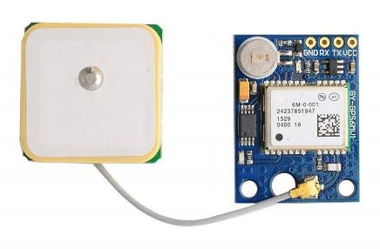
Hardware Components
System Overview
Arduino Uno R3
MPU 6050 Sensor
GSM SIM 800L
GPS neo6m Module
Pulse sensor

Slide 7
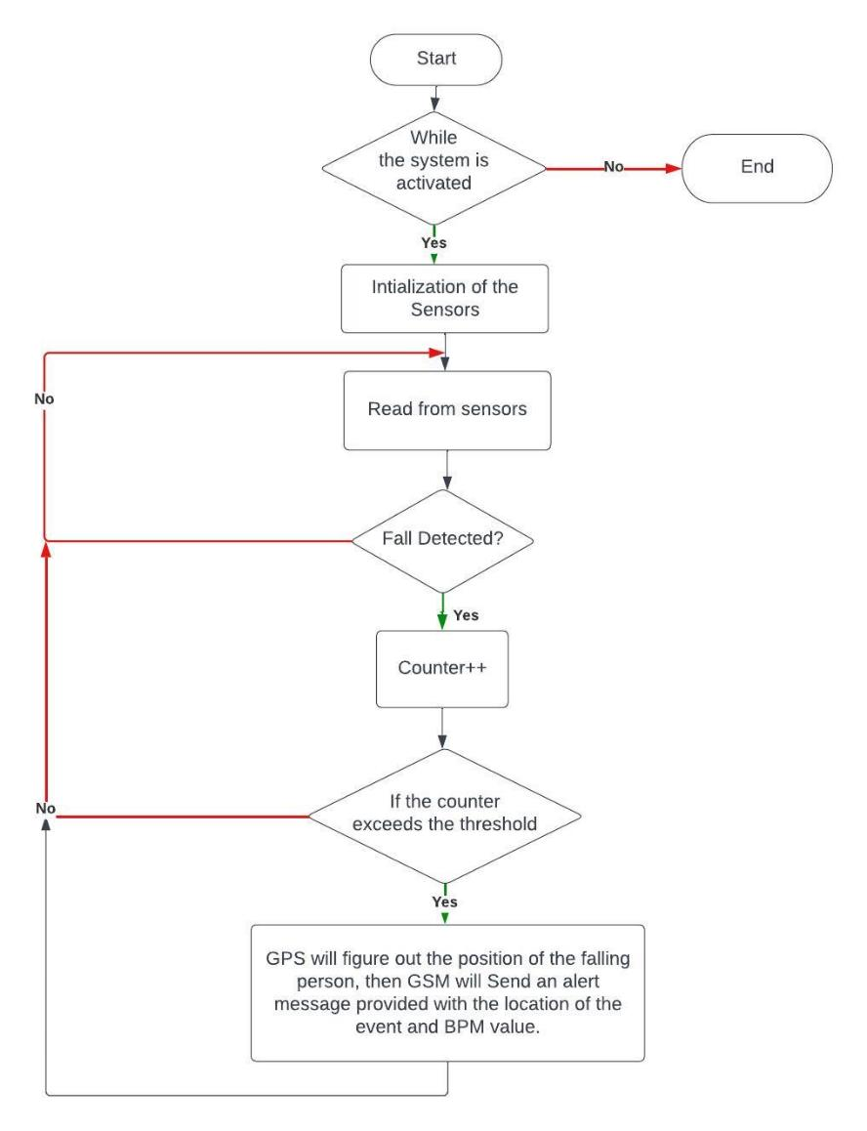
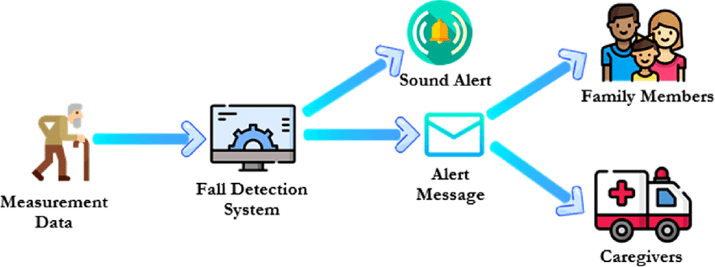
Flow Chart
System Overview

Slide 8
Fall Detection System
Budget
Component | Store | Cost (LYD)
Arduino uno R3 | القدرة الرقمية | 45
MPU6050 | القدرة الرقمية | 15
Pulse sensor | القدرة الرقمية | 25
GSM SIM800L | Asas Company | 50
GPS neo6m | القدرة الرقمية | 50
Total | - | 185

Slide 9
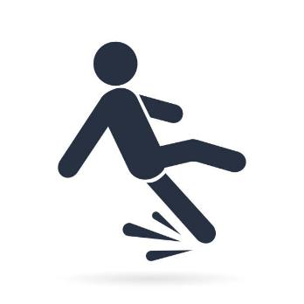
THANK YOU

